Slide 1







CS-363 TERM PAPER REVIEW
Title: QuIM-RAG
Advancing Retrieval-Augmented Generation With Inverted Question Matching for Enhanced
QA Performance
Presented by Batch-07

Slide 2




Batch - 07
Review - 1
Guide:
Dr. M. Sreelatha
Instructor:
Smt. N. Zareena
Team Members:
Pradeep Kumar (Y22CS048)
Naga Avinash Babu (Y22CS044)
Poleru Yadav (Y22CS042)

Slide 3


AGENDA...
Abstract
Existing Systems
Drawbacks of Existing Systems
Introduction
Basic Concepts
Literature Survey
Architecture Diagrams
Methodology

Slide 4



Abstract...
Large Language Models (LLMs) are powerful tools that analyze and generate human-like text but struggle with real-time updates.
Retrieval-Augmented Generation (RAG) improves LLMs by integrating online resources for more accurate and context-aware answers.
Traditional RAG models face challenges like handling large amounts of data, leading to information dilution and incorrect responses (hallucinations).
Introduces QuIM-RAG (Question-to-question Inverted Index Matching), a new method that improves how AI retrieves relevant information.
Instead of simply searching documents, QuIM-RAG generates possible questions from document chunks and matches them with user queries for better accuracy.

Slide 5
Contd...
The system is built on Meta-LLaMA3-8B-instruct, an open-source AI model, and is tested using a custom dataset of 500+ pages from a popular website.
A manual QA evaluation was performed to ensure high accuracy and reliability of responses.
The performance of QuIM-RAG was compared with traditional RAG models using BERT-Score and RAGAS, two advanced AI evaluation methods.
Results show that QuIM-RAG outperforms traditional RAG systems by generating more precise and reliable answers.
This research provides a better way to retrieve and generate answers, making AI-driven question-answering more effective.

Slide 6


A quick view on some Existing Methodologies...
Fine -Tuning
of LLMs
Involves additional training of pre-existing large language models (LLMs) on domain-specific datasets.
Optimizes model performance for specific tasks by adapting it to specialized knowledge.
Enhances accuracy in generating responses relevant to niche topics.
Combines LLMs with external knowledge sources to improve contextual accuracy in responses.
Retrieves relevant documents based on user queries and generates answers using the retrieved content.
Allows LLMs to adapt to various domains flexibly without extensive retraining.
Traditional RAG Systems

Slide 7
Drawbacks of Existing Systems...
Information Dilution
When too many documents are retrieved in response to a query, the model may struggle to identify the most relevant information.
The responses can become vague or overly broad, lacking specificity.
The model finds it challenging to focus on key details that directly answer the user’s question, leading to less effective communication.
Hallucination
Traditional RAG systems may generate outputs that sound plausible but are factually incorrect or irrelevant.
Users may receive answers that seem coherent but are actually wrong, which can erode trust in the system.
This can confuse users, as they might believe they are receiving accurate information when they are not.

Slide 8
Drawbacks of Existing Systems...
Computational Complexity
The retrieval process in traditional RAG systems can be resource-intensive, especially when handling large datasets.
High computational demands can lead to delays in generating responses, frustrating users who expect quick answers.
Organizations may face increased costs due to the need for powerful hardware and optimized algorithms to manage large volumes of data.
Limited Domain Adaptation
While RAG systems can adapt to various domains, they often struggle with highly specialized questions that require specific knowledge.
The system may not perform well in niche areas where detailed expertise is necessary, resulting in incomplete or inaccurate answers.
Traditional models trained on broad datasets may fail to capture the nuances required for specialized fields like law or medicine.

Slide 9
Introduction...
LLMs face challenges in answering domain-specific questions due to issues like knowledge limitations, contextual misinterpretation, and task-specific variability.
Two primary strategies to address these challenges are fine-tuning the models with domain-specific data and augmenting them with external knowledge.
Fine-tuning can improve model performance but is computationally expensive and risks losing previously learned information.
Fine-tuning is also less practical in fields with limited relevant data, making it less effective for some specialized domains.

Slide 10
Contd...
Retrieval-Augmented-Generation (RAG) is an alternative method that improves LLM performance by incorporating external knowledge to generate more accurate and contextually appropriate responses.
Despite RAG’s effectiveness, it faces challenges like information dilution, where large volumes of data compromise accuracy, and hallucination, where the model generates factually incorrect responses.
RAG relies on vectorization, using embedding models to transform text into numerical representations (vectors) to allow efficient similarity search.

Slide 11
Contd...
The system compares query vectors with dataset vectors using cosine similarity to retrieve the most relevant text chunks.
The modified RAG system, QuIM-RAG, introduces a novel question matching approach and a quantized embedding index to improve retrieval efficiency and answer precision.

Slide 12
Basic Concepts…
Natural Language Processing
NLP helps computers understand and work with human language.
It is used in tasks like language translation, sentiment analysis, and chatbots.
LLMs are AI models that generate human-like text using deep learning.
They are used for tasks like writing text, answering questions, and translating languages.
Large Language Model
Retrieval-Augmented Generation
RAG combines information retrieval with text generation to improve accuracy.
It helps generate more relevant and precise answers using external data.

Slide 13
Basic Concepts…
Vector Embeddings
Vector embeddings represent words or text as numbers that capture their meaning.
They are used to compare and find similarities between words or phrases.
QA systems automatically respond to questions in natural language.
They are used in virtual assistants, customer support, and search engines.
Question Answering (QA)
Inverted Index
An inverted index maps words to the documents where they appear.
It speeds up the process of retrieving documents that contain specific words.

Slide 14
Basic Concepts…
Cosine Similarity
Cosine similarity measures how similar two text vectors are.
It is commonly used in search engines to find the most relevant documents.
Quantization reduces the amount of data by grouping values into fewer categories.
It is used to make models more efficient by reducing memory and processing requirements.
Quantization
Web Scraping
Web scraping is the process of extracting data from websites automatically.
It is used to gather large amounts of information from the web, like articles, product prices, or reviews.

Slide 15
Literature Survey...
Fine-Tuning or Retrieval? Comparing Knowledge Injection in LLMs
Authors : Oded Ovadia, Menachem Brief, Moshik Mishaeli, Oren Elisha.
Main Features:
Compares fine-tuning and retrieval-augmented generation (RAG) as methods for injecting knowledge into large language models.
Evaluates performance across various knowledge-intensive tasks.
Highlights the advantages of RAG in incorporating new and domain-specific information.
Drawbacks
Does not propose a specific method to enhance retrieval effectiveness.
Provides a comparative analysis but lacks a novel retrieval mechanism

Slide 16
CONTD...
Retrieval-Augmented Generation for Large Language Models: A Survey
Authors : Yunfan Gao, Yun Xiong, Xinyu Gao, Kangxiang Jia, Jinliu Pan, Yuxi Bi, Yi Dai, Jiawei Sun, Meng Wang, Haofen Wang.
Main Features:
Provides a comprehensive survey of retrieval-augmented generation (RAG) techniques for large language models.
Discusses various paradigms, including Naive RAG, Advanced RAG, and Modular RAG.
Examines the integration of retrieval mechanisms with generative models to enhance performance.
Highlights the importance of combining internal model knowledge with external databases.
Notes:
Drawbacks Compared to QuIM-RAG:
Offers a broad overview without delving into specific innovative retrieval methods like QuIM-RAG's inverted question matching.
Lacks experimental validation of proposed methods.

Slide 17
CONTD...
Retrieving Supporting Evidence for Generative Question Answering
Authors : Siqing Huo, Negar Arabzadeh, Charles L. A. Clarke.
Main Features:
Investigates methods to retrieve supporting evidence for answers generated by language models.
Focuses on validating generated answers against external corpora to reduce hallucinations.
Utilizes a retrieval pipeline combining sparse and dense retrieval methods.
Employs neural re-rankers to enhance the relevance of retrieved evidence.
Notes:
Drawbacks Compared to QuIM-RAG:
Emphasizes post-generation validation rather than improving the retrieval process during generation.
Does not propose a novel retrieval mechanism like QuIM-RAG's inverted question matching.

Slide 18
CONTD...
Internet-Augmented Language Models through Few-Shot Prompting for Open-Domain Question Answering
Authors : Angeliki Lazaridou, Elena Gribovskaya, Wojciech Stokowiec, Nikolai Grigorev.
Main Features:
Enhances language models by conditioning them on information retrieved from the internet using few-shot prompting.
Aims to ground models in up-to-date and factual information for open-domain question answering.
Combines few-shot learning with retrieval from the web to inform model responses.
Leverages search engines to access a broad and current knowledge base.
Notes:
Drawbacks Compared to QuIM-RAG:
Relies on few-shot prompting, which may not be as effective in generating relevant questions for retrieval as QuIM-RAG's method.

Slide 19
CONTD...
Empower Large Language Model to Perform Better on Industrial Domain-Specific Question Answering
Authors Fangkai Yang, Pu Zhao, ZezhongWang
Main Features:
Domain-Specific Knowledge Integration – A small fine-tuned AI model (trained on industry-specific documents) provides specialized knowledge to GPT-4/GPT-3.5 before generating answers.
Improved QA Accuracy – The proposed method outperforms traditional retrieval-based approaches (BM25, DPR) by providing more relevant, precise, and context-aware answers
No Expensive Full Fine-Tuning Needed – Instead of retraining large LLMs (which is costly), this approach trains a smaller helper model that supplies domain knowledge to the main LLM.

Slide 20

Aim of Methodology
Given a specific natural language question, the QA problem for a limited corpus is to identify and extract the most relevant and accurate answer from a predefined and constrained set of documents. The challenge lies in efficiently finding the most relevant answer that fits the question, taking into account the limited resources. Our key contribution is to pose finding the relevant answer as a matching process between potential questions that could have been asked for a document chunk with the actual user question.
So to achieve this we follow these “Three Phase Model”.

Slide 21
Methodology with Architecture Diagrams…
Phase-I of Methodology
Web Scraping:
The system scrapes data from the websites:
Extracted HTML content is cleaned by removing headers, footers, and redundant data.
Chunking & Overlapping Windows:
The scraped text is broken into 1000-token segments with an overlapping window of 200 tokens to retain contextual continuity.
Question Generation:
GPT-3.5-turbo-instruct generates multiple potential questions from each chunk.
Ensures that all key information in a chunk is covered by at least one question.
Final Structured Dataset
Each chunk is stored along with its generated questions and source links.
This dataset forms the basis for retrieval in the later phases.

Slide 22
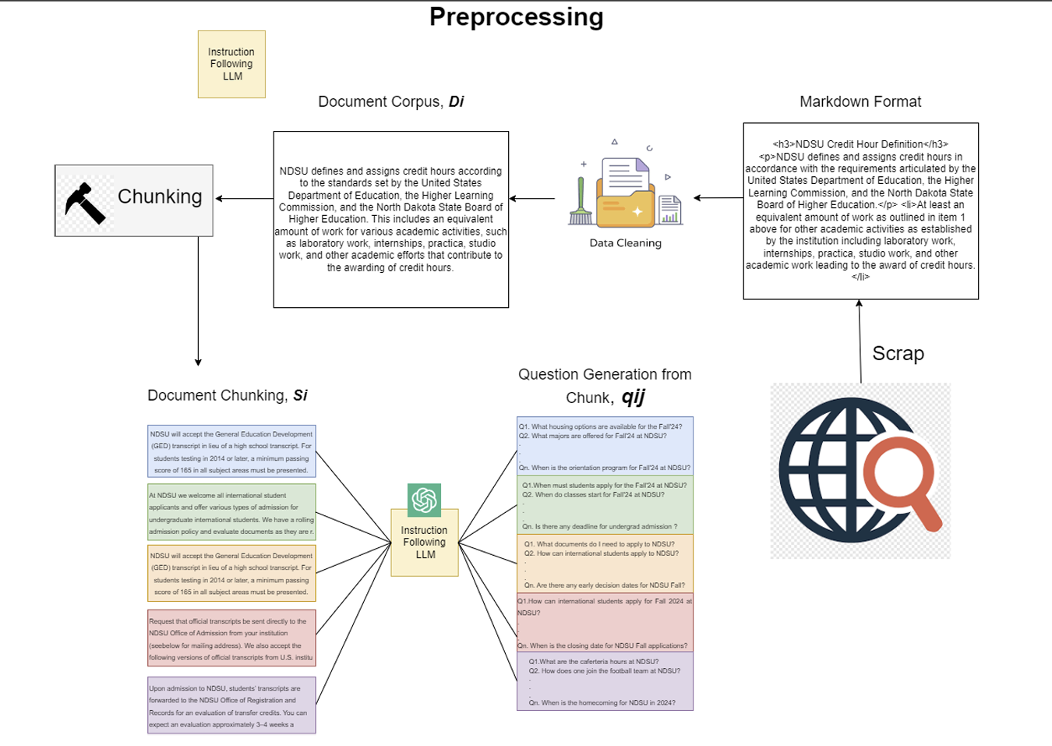

Phase-I Architecture Diagram ...
Overall Architecture of Corpus Preparation

Slide 23
Phase – II of Methodology
Embedding Questions & Chunks::
Generated questions are converted into vector embeddings using BAAI/bge-large-en-v1.5 from Hugging Face.
Each chunk also has an associated embedding.
Quantization & Inverted Indexing:
Embedding vectors are quantized to prototype vectors, reducing storage and improving retrieval speed.
The system creates an inverted index, mapping each prototype vector to its corresponding questions and chunks.

Slide 24
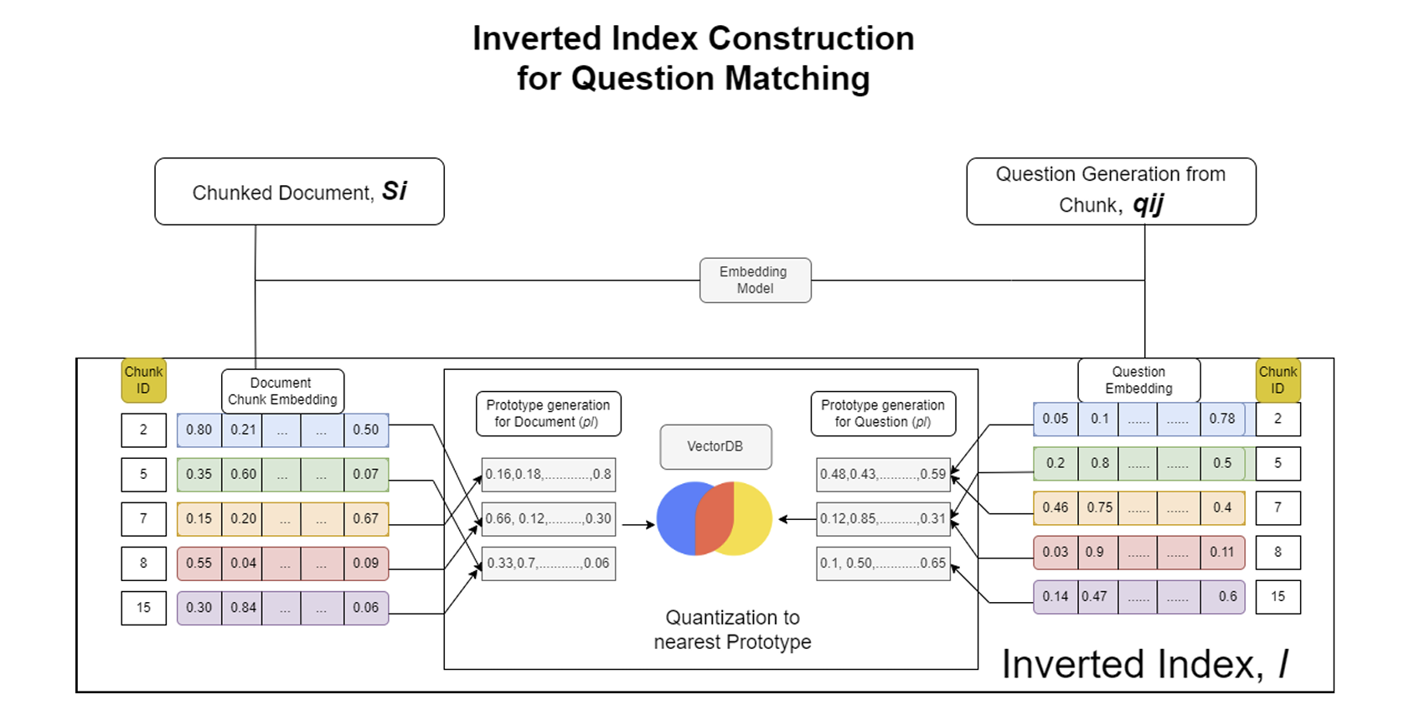
Phase-II Architecture Diagram ...

Slide 25
Phase – III of Methodology
Query Processing:
The user submits a question.
It is embedded and quantized using the same vectorization method as the stored data.
Question Matching & Retrieval:
The system finds the top k matching questions in the inverted index.
Corresponding document chunks are retrieved.
Answer Generation with Llama3-8B-instruct::
Retrieved chunks are fed into Meta-LLaMA3-8B-instruct.
The model generates a contextually accurate response using a custom
prompt.
The user receives a well-structured, contextually relevant answer

Slide 26
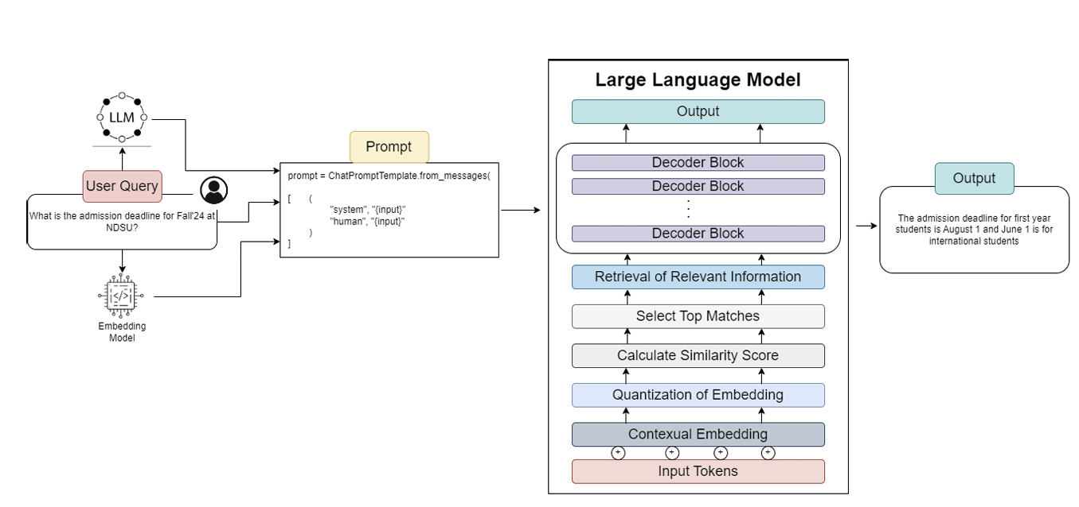
Phase-III Architecture Diagram...
Overall Retrieval and Generation Architecture for RAG.

Slide 27

Wind up…
The QuIM-RAG system improves how answers are found by matching user questions with related questions in the database, leading to more precise and relevant responses.
A carefully created dataset, gathered from reliable sources and reviewed manually, ensures accurate information while reducing errors and misinformation.
The system performs better than traditional methods in key areas like answer accuracy and relevance, as shown by evaluation tests.
Regular updates to the data and user feedback will help make the system even more reliable and useful over time.

Slide 28



